Slide 1
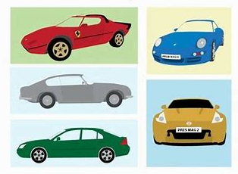
BATCH H-3
ANALYSIS OF USED CAR SALES AND PREDICTION OF SELLING PRICE
Sarana Poornachand DELBC8011
Ronanki Sai Charan DELBC8012
Radhika Menon DELBC8013
Sharmili Tangellapalli DELBC8014
Vishnu Vardhan Chinnam DELBC8015
Mentor : Pudota, Nirmala
Coach : Dave, Raghav

Slide 2
ABOUT THE PROJECT
Domain:
Automotive Industry
About:
This is about an automobile company XYZ from USA which aspires to enter the US used car market by setting up their company locally to give competition to their counterparts.

Slide 3
PROBLEM STATEMENT
The purpose of the project is to understand the factors affecting the pricing of cars in the market based on the data given and build a Machine Learning model that involve in predicting the selling price of used cars.
The following are the main goals:
Which variables are significant in predicting the price of a used car?
How well those variables describe the price of a car

Slide 4
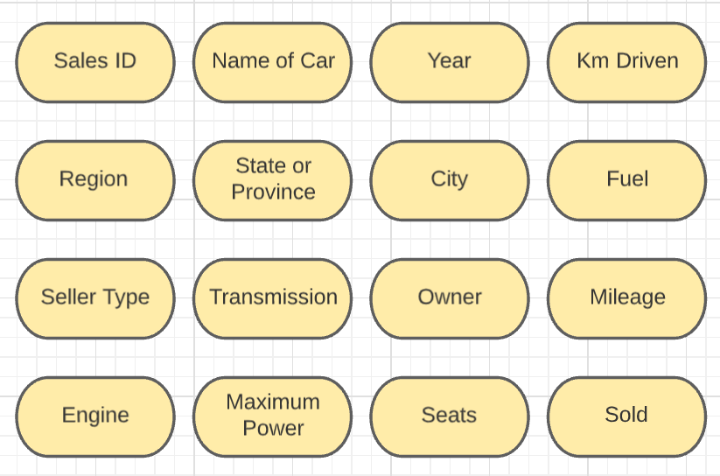
Description of Data

Slide 5

Target Column: selling_price
Independent Features | Year, Fuel type, Seller type, Transmission type, owner, mileage, max power, engine cc
Dependent Feature | Selling Price

Slide 6

DATA PREPROCESSING

Slide 7
DATA INTEGRATION AND CLEANING
Merging the given datasets
Missing Values Analysis and Treatment
Removing and Filtering unwanted data
Outlier analysis and Treatment

Slide 8
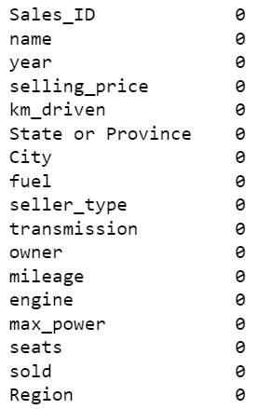
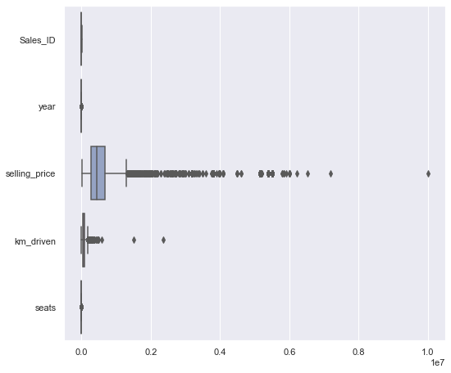
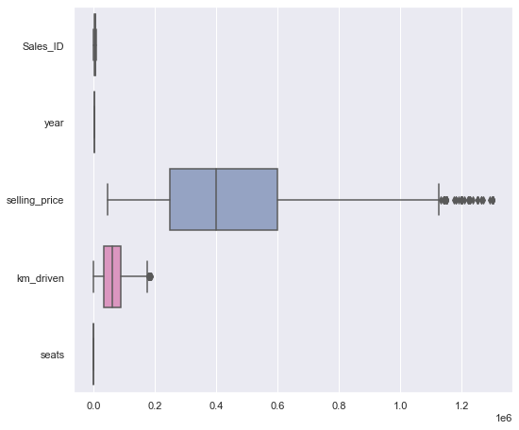
Missing Values
Treatment
Outlier
Treatment

Slide 9
DATA TRANSFORMATION
Data Manipulation
Normalization
Scaling of the data

Slide 10
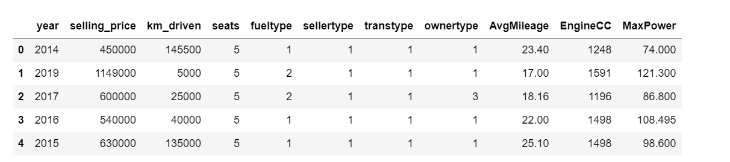
The following picture shows the data after performing the necessary analysis.
This data is used for building the model for Machine Learning.
This is the data after scaling and Z-score Normalization.
We perform Dummy Encoding for the categorical columns.
Data after Transformation

Slide 11
Data Visualization Using Python
Graphical Representation of Data.
By using visual elements like charts, graphs, maps and data visualization tools.
Python Libraries for Data Visualization are:
Matplotlib : Creates interactive visuals in Python
Seaborn: High level Interface for drawing informative Statistical Graphics.

Slide 12
Data Visualization Using Python
Univariate Analysis:
Analysis done on one dependent variable.
Different types of graphical representations are Histogram, Density plot, Box plot, Count plot, Bar chart, Pie chart and Donut chart.
Bivariate Analysis
Describing the relationship between two variables.
Different types of graphical representations are Scatter plot, Heatmap are some graphical representations.
Now let us look some visualizations that help in analyzing car sales.

Slide 13
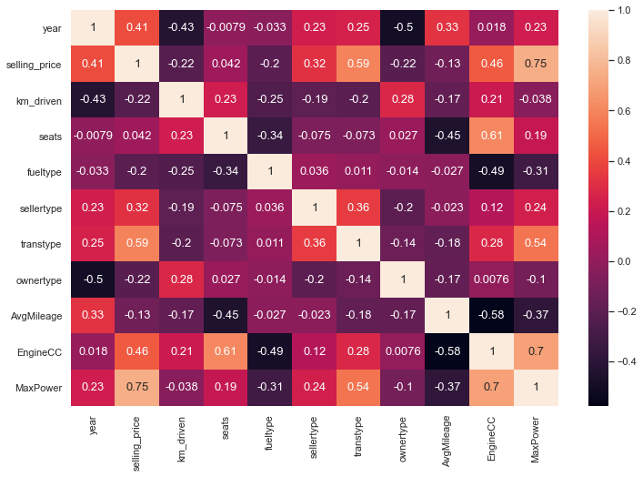
Multivariate Analysis of the Features using a Heat Map
Correlation
Values
for
different
features

Slide 14
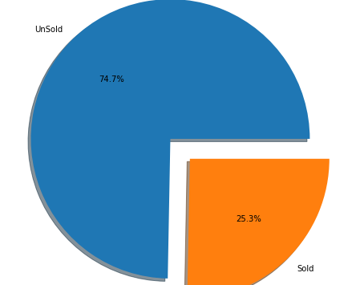
Sold vs Unsold Cars
Overall sales of used cars in the data set given.
Sold/Unsold | Count
Unsold | 5906
Sold | 2000

Slide 15
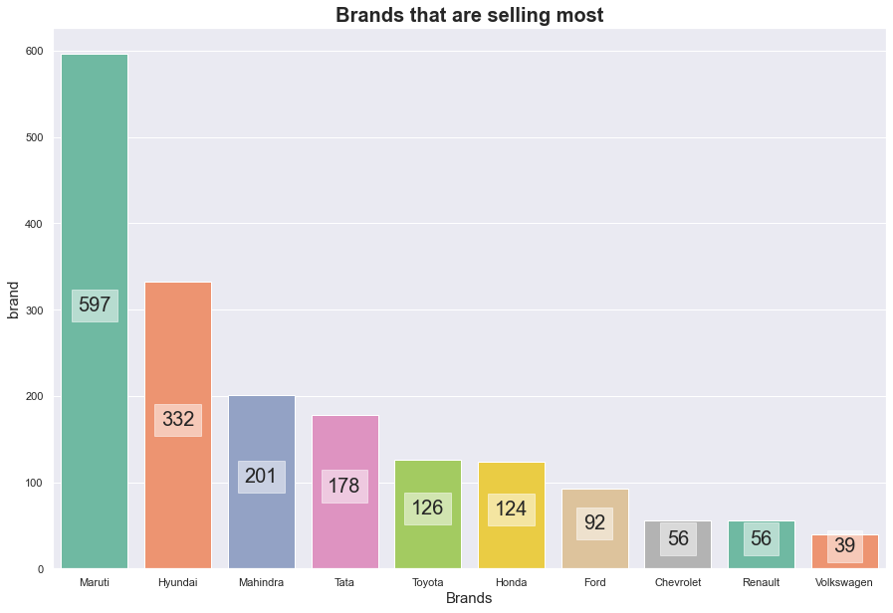
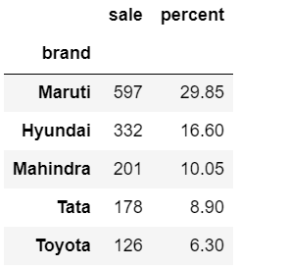
Car Brands with Highest number of Sales
Maruti Cars were selling most with 29.85% sales.

Slide 16
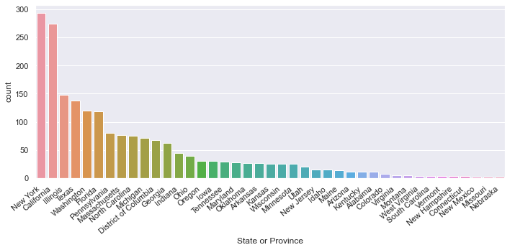
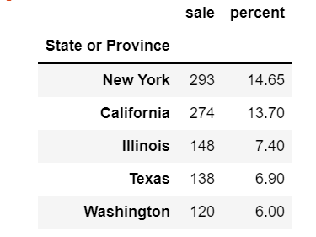
States with higher car sales
In New York State Car Sales were high with 14.65% .

Slide 17
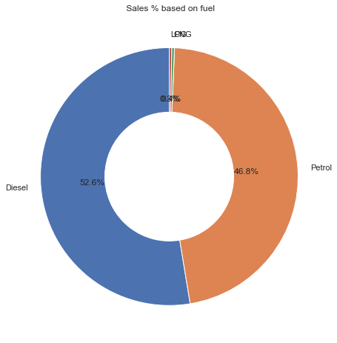
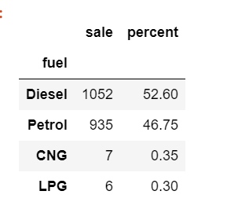
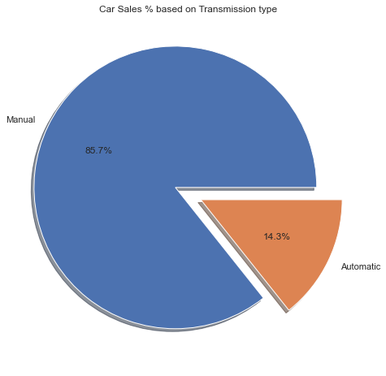
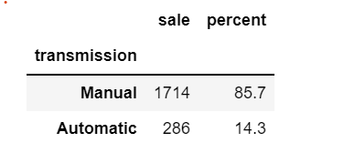
Car Sales Based on Transmission type and fuel type
Most of the used cars sold were of Manual type and Diesel cars.

Slide 18
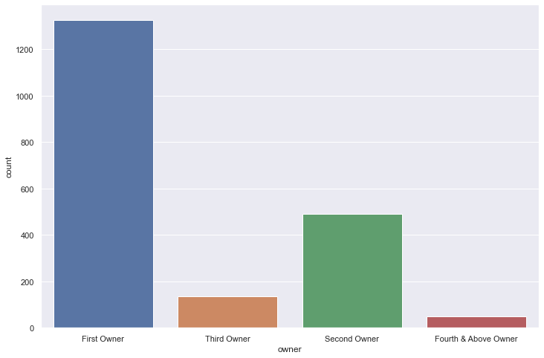
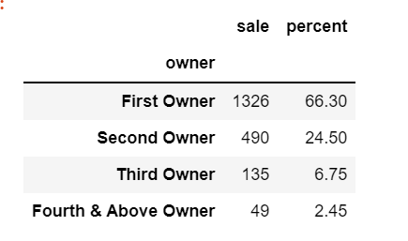
Car Sales based on Owner Type
Single owner cars were sold the most

Slide 19
Data Visualization Using Power BI
Collection of Software Services, Apps
Turns unrelated data sources into interactive visual insights.
Helps to gain deeper data knowledge
End to End data protection
Better together
Extensive Data Connectors
Excel data, CSV data etc..,

Slide 20
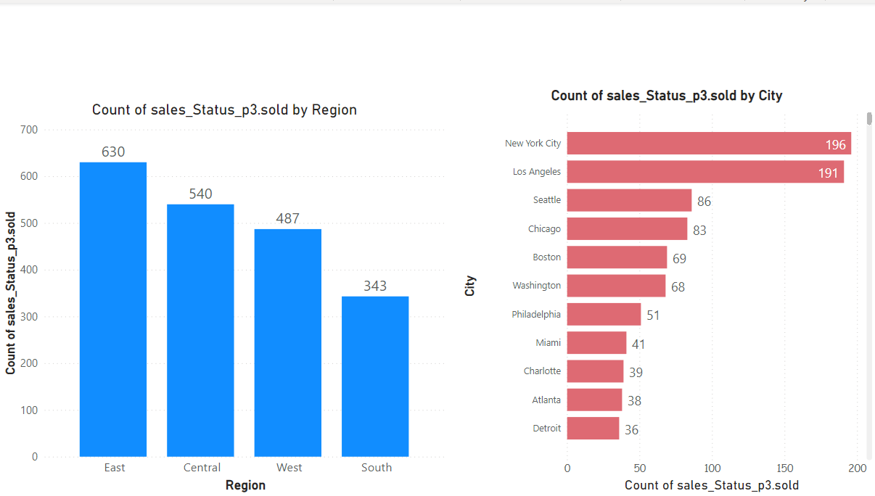
Highest Car Sales by Region and City
East Region has highest number of sales.
New York city has highest number of sales.

Slide 21
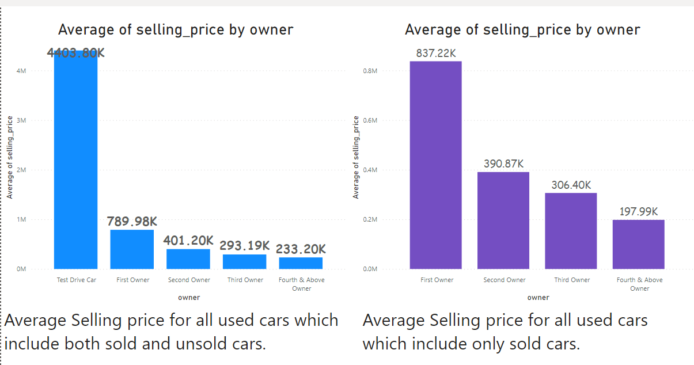
Average Selling Price by Owner

Slide 22
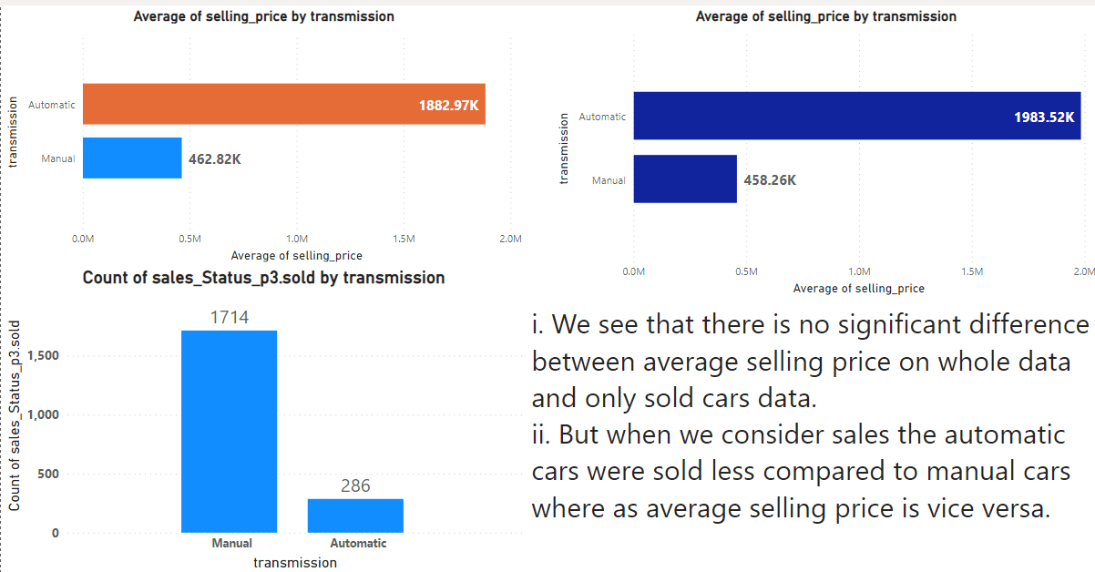
Average Selling Price by Transmission Type

Slide 23
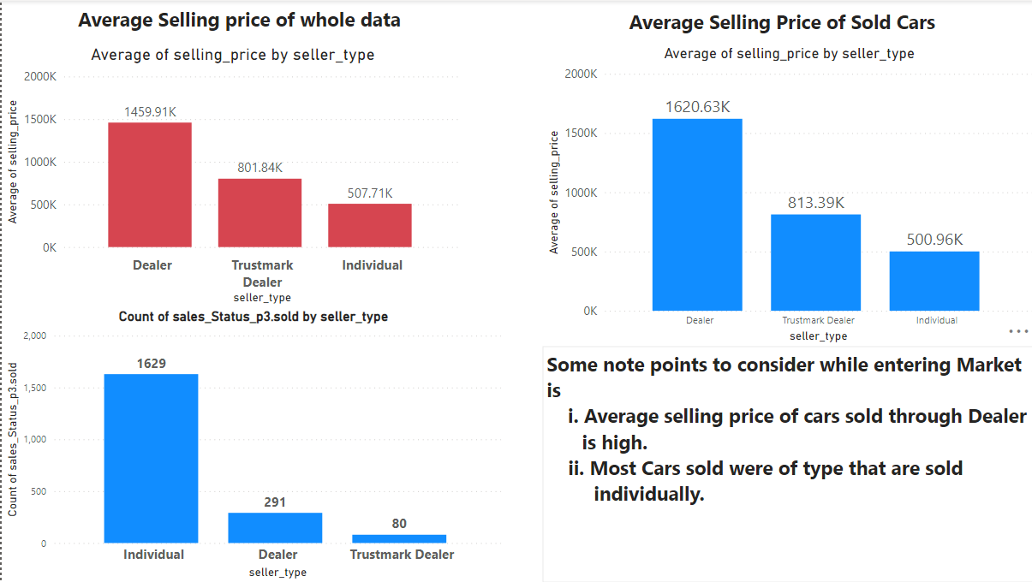
Average Selling Price by Seller Type

Slide 24
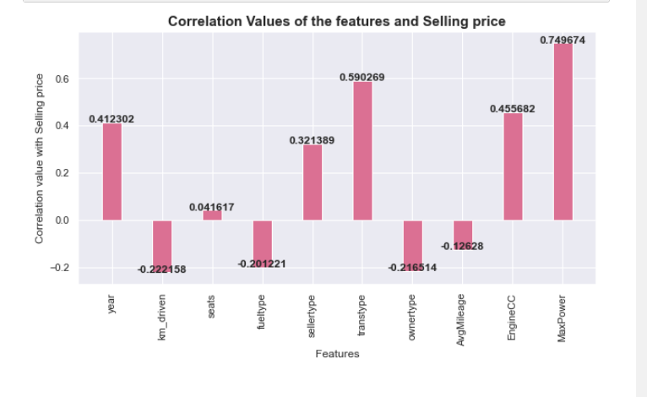
Most Important Features
The following graph depicts how well do the features describe the selling price of the car.
year
sellertype
Transmission type
EngineCC
MaxPower

Slide 25
Machine Learning Models

Slide 26
Models Compared
Ordinary Least Squares(OLS) Regression model
Linear Regression model
Decision Tree Regression model
Ensemble Regression Models
Adaboost Regression Model
Gradient Boosting Regression Model
Random Forest Regression Model
XGBoost Regression Model
Deep Neural Network Model

Slide 27
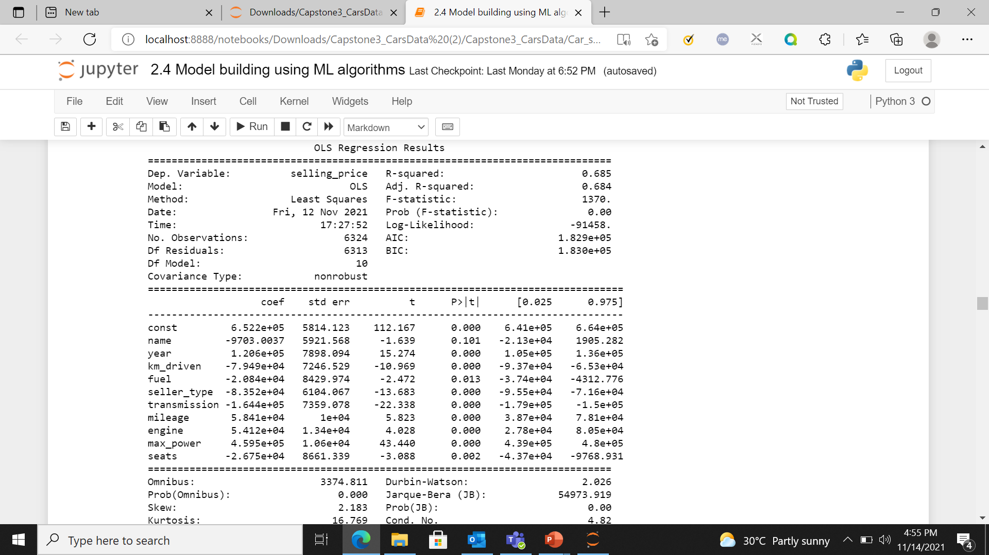
OLS REGRESSION
Removing attributes with pvalue>0.05.
The Rsquared should not reduce.

Slide 28
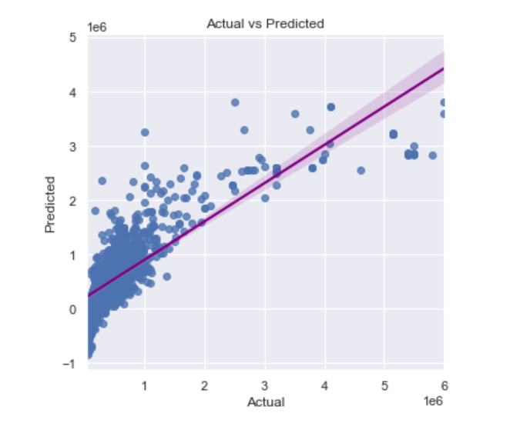
LINEAR REGRESSION
Linear regression model is trained on train data and run-on test data.
Regularization is done using Lasso Regression, Ridge regression and Elastic net regression.
Best predictions obtained with Ridge regression and lambda value of 10.

Slide 29
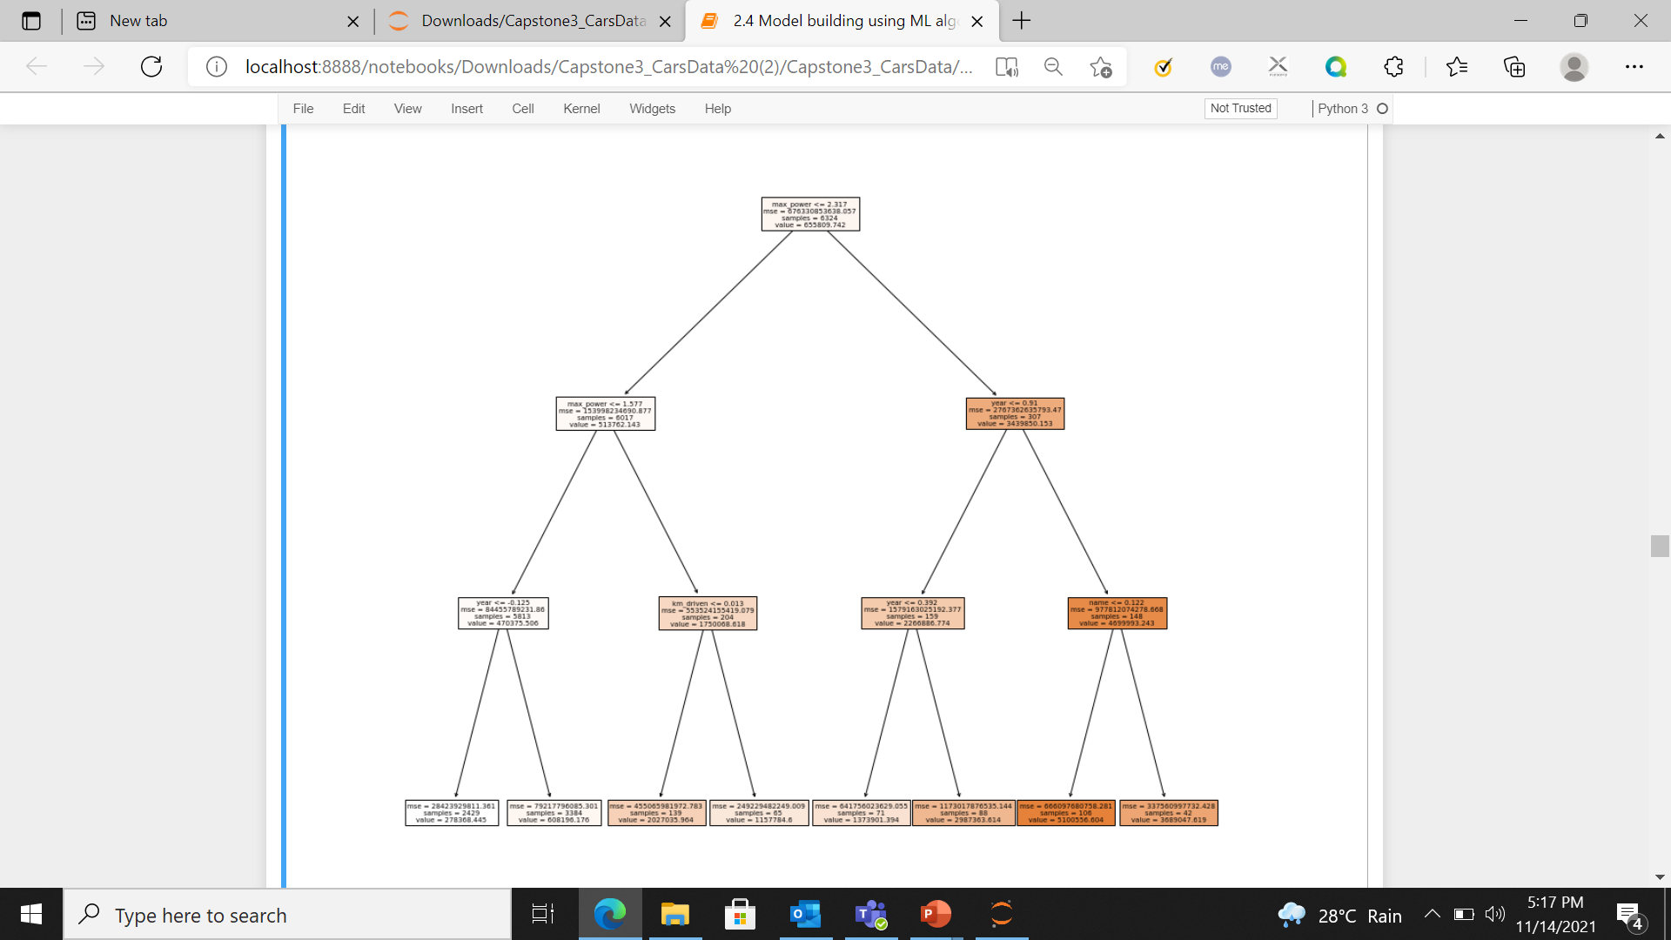
DECISION TREE REGRESSION
Decision tree regressor is run with tuning the max depth.
The best parameter of maximum depth of 7 is used as it gave best predictions.

Slide 30
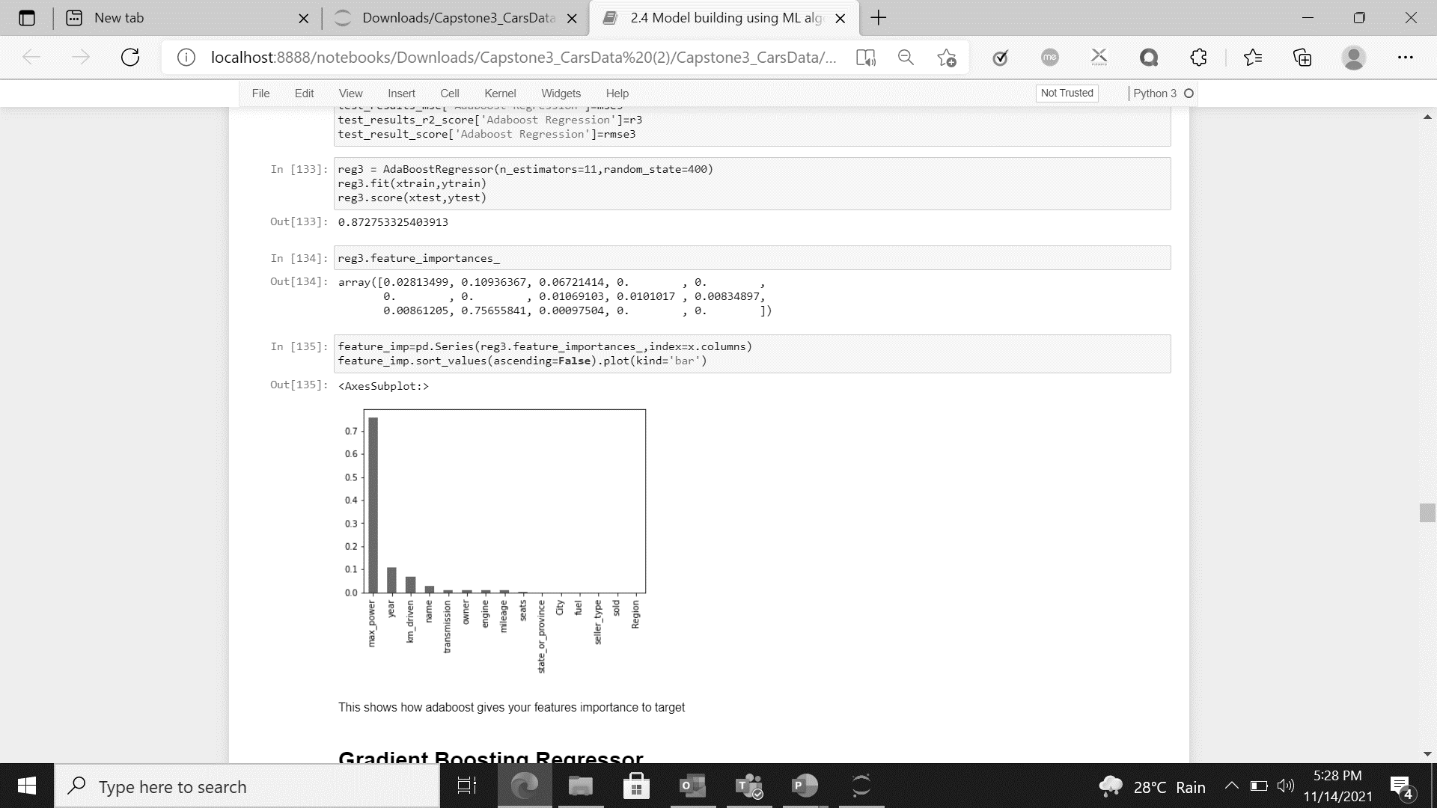
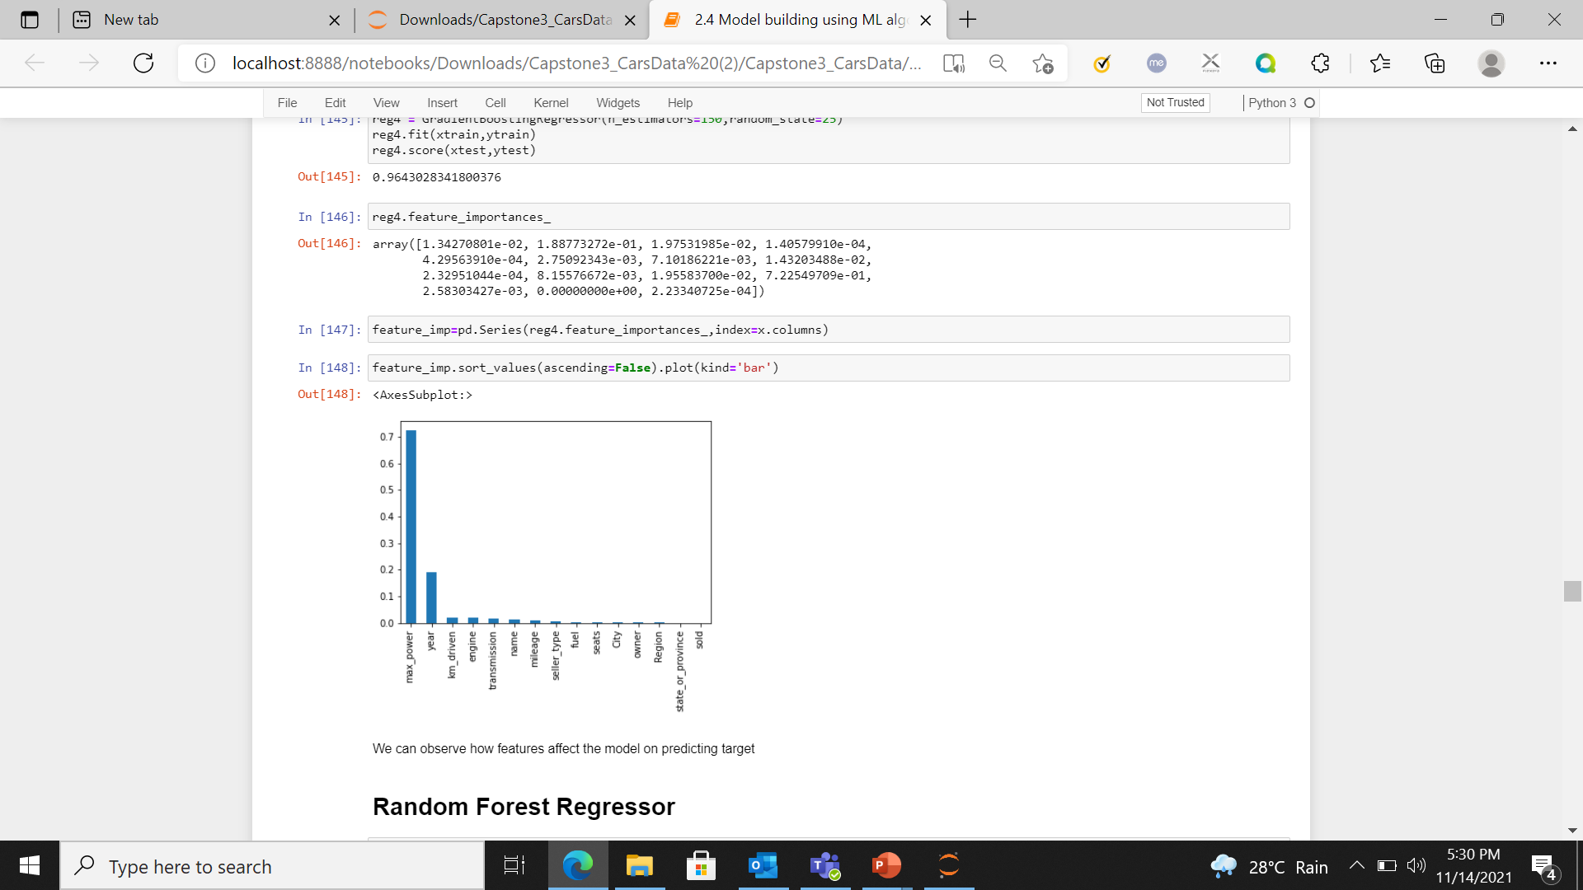
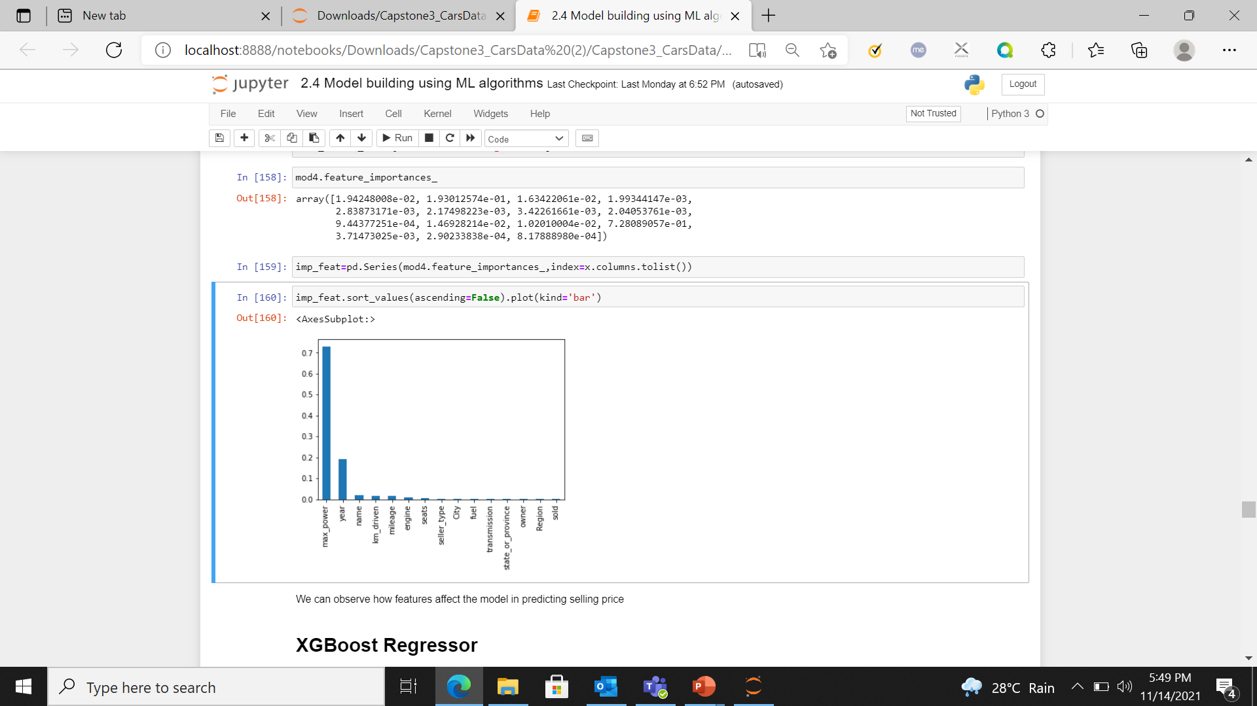
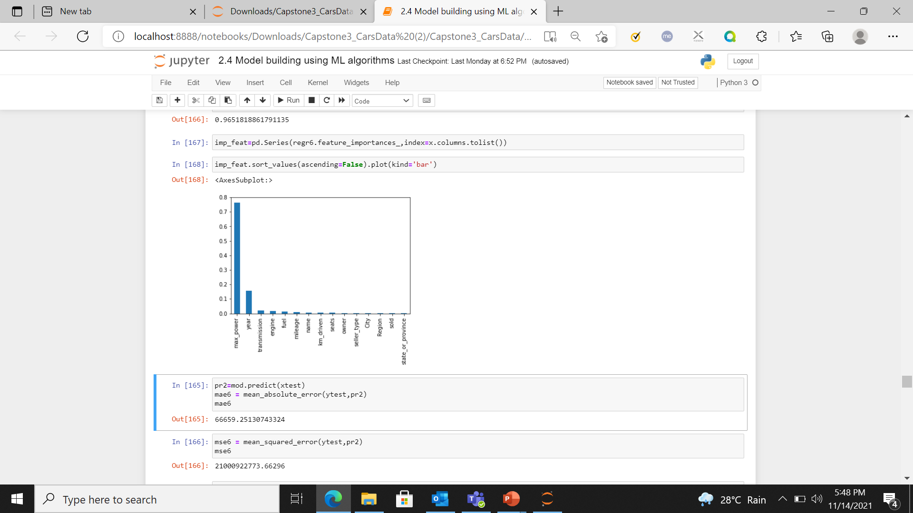
ENSEMBLE MODELS
ADABOOST REGRESSION
GRADIENT BOOSTING REGRESSION
RANDOM FOREST REGRESSION
XGBOOST REGRESSION

Slide 31
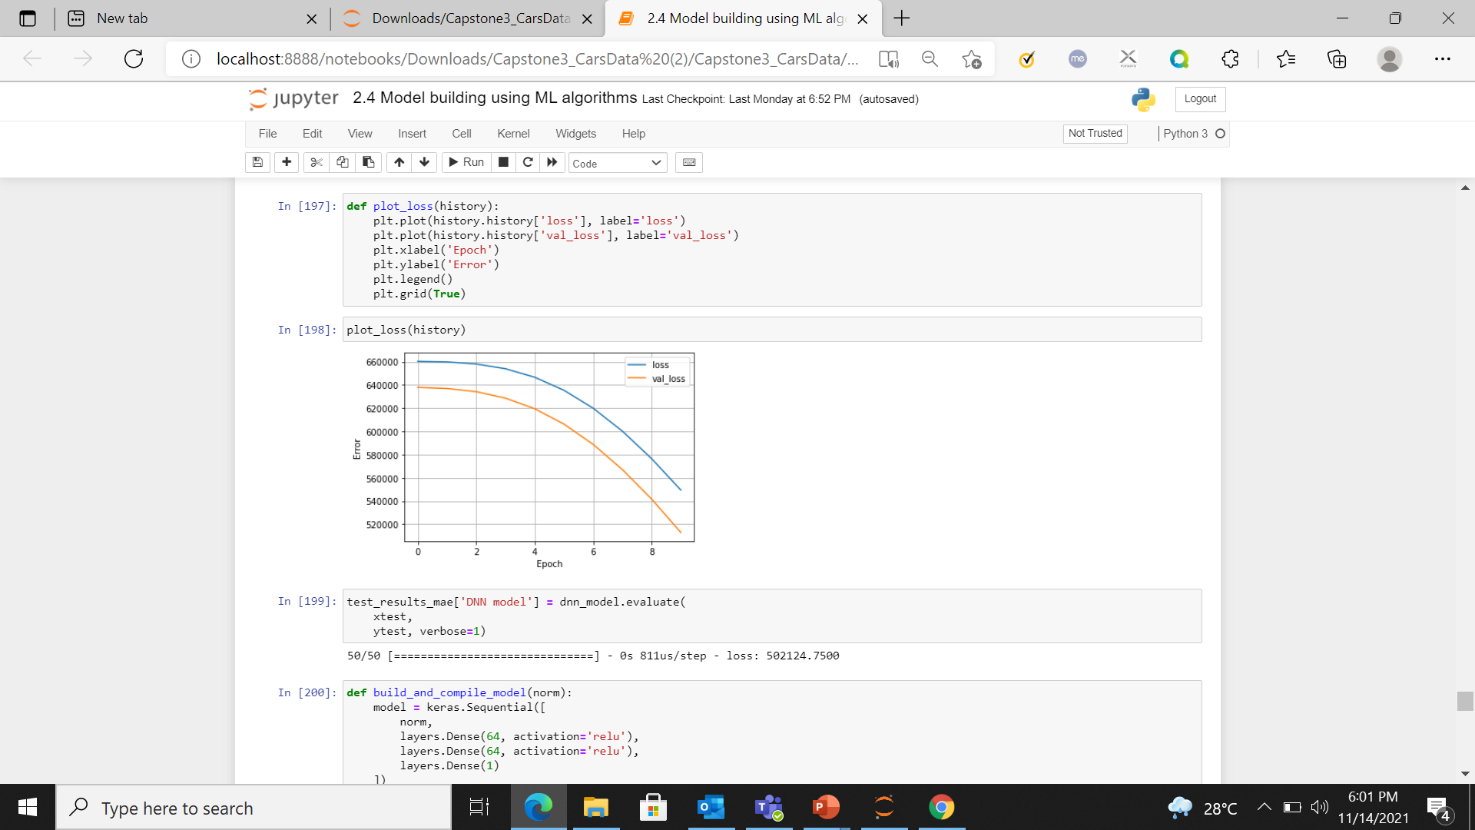
DEEP NEURAL NETWORK
DNN was run for 10 epochs and loss is plotted as below.

Slide 32
METRICS FOR COMPARISON
The Mean Absolute Error you get is in the same unit as the output variable.
It is most Robust to outliers.
The graph of Mean Squared Error(MSE) is differentiable, so one can easily use it as a loss function.
As the value obtained from MSE is too big Root Mean Squared Error value is used to bring to scale which is normal.
All the above talks about losses, R2_score tells the performance of your model.
One can use all these metrics combination to come to a strong conclusion.

Slide 33
COMPARISON OF MODELS
Metrics | OLS Regression | Linear Regression-Ridge | Decision Tree Regression | Adaboost Regression | Gradient Boosting Regression | Random Forest Regression | XGBoost Regression
MAE | 276637.2 | 276330.1 | 107041.1 | 191733.6 | 793119.5 | 673036.8 | 666592.5
MSE | 200933100000.0 | 200317500000.0 | 47427550000.0 | 76750210000.0 | 21531130000.0 | 16790920000.0 | 21000920000.0
R2_Score | 0.67 | 0.68 | 0.92 | 0.87 | 0.96 | 0.97 | 0.96
RMSE | 448255.6 | 447568.4 | 217778.7 | 277038.3 | 146734.9 | 129579.8 | 144917.0

Slide 34
Conclusion from Machine Learning models
From the observation we can see that Random forest regressor got Lowest Mean Squared Error, Lowest Root Mean Squared Error and highest r2_score .
Thus, Random forest regressor is considered as the best model among the compared ones.

Slide 35
DATA ENGINEERING AND ETL
Loading data to spark
Merging dataset
Saving to hive

Slide 36
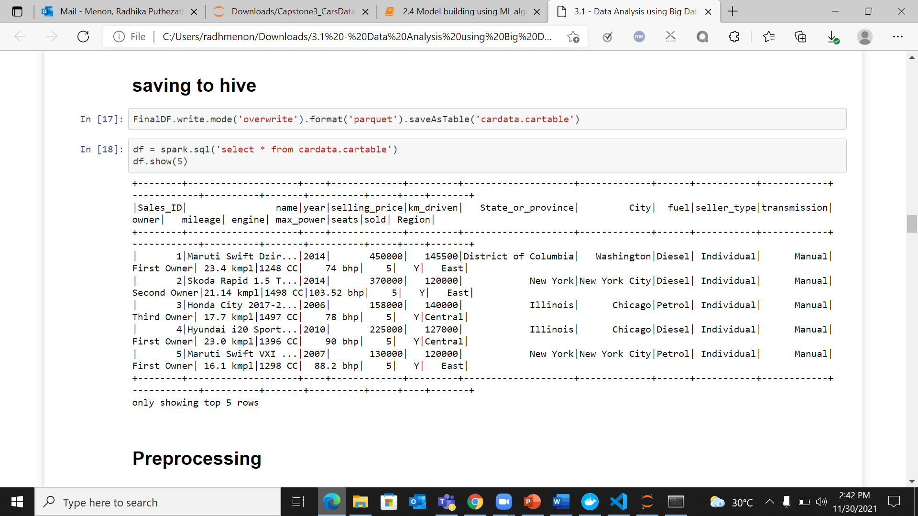
Saving Data as a table in HIVE

Slide 37
DATA ENGINEERING AND ETL
Loading from hive
Preprocessing
Random Forest Regressor modeling

Slide 38
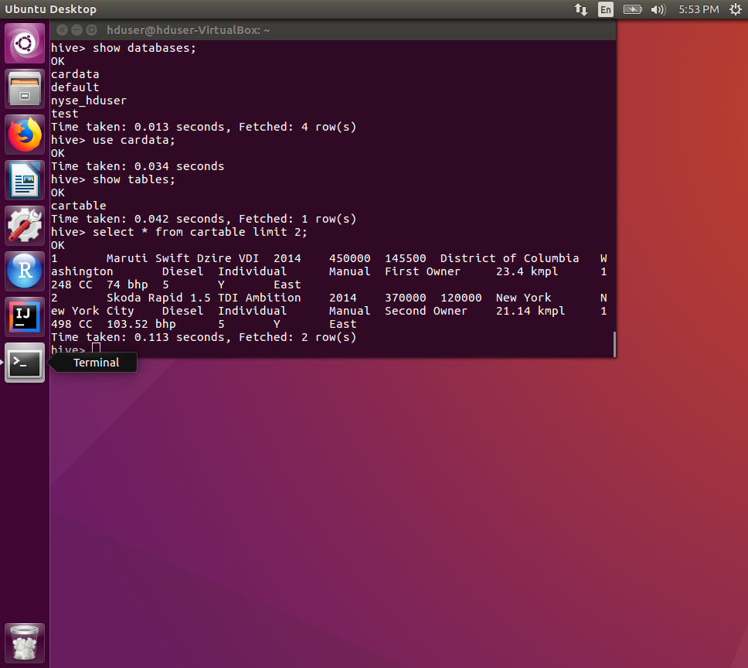
Loading data from HIVE

Slide 39
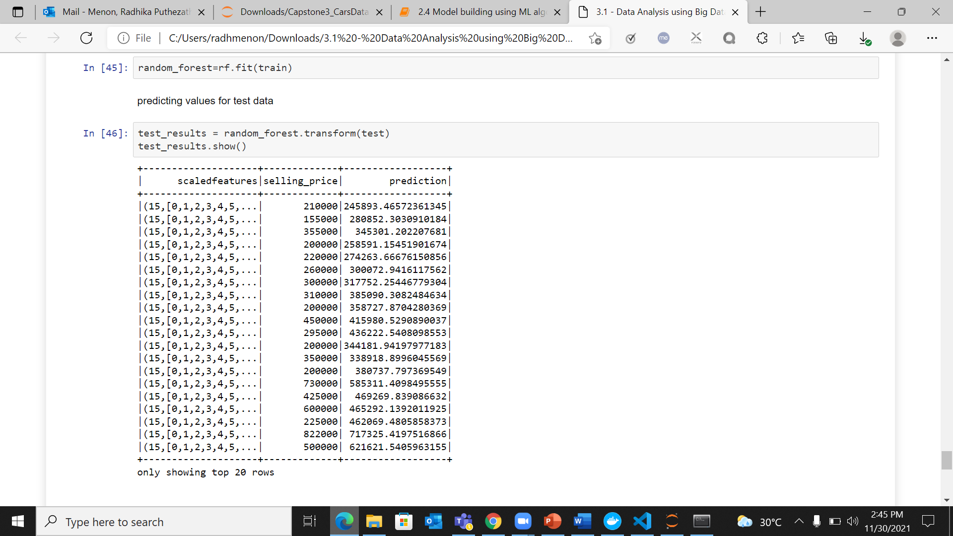
Random Forest Regression Using MLLIB

Slide 40
Mean Absolute Error
114434.29
Evaluation of the Model based on different metrics
Mean Squared Error
34528300691.176
R2 Score
0.947826546
Root Mean Squared Error
185817.92

Slide 41

Cloud Technology AZURE

Slide 42
Virtual Machines
Managing and Monitoring Virtual Machines
Configuring Virtual Machines Security
Creating Virtual Machines
Azure Virtual Machine Sizing
Configuring Virtual Machines

Slide 43
Virtual Network
Creating and Configuring Virtual Networks
Configuring VPN connectivity
Load Balancers
Network Security Groups
Traffic Manager

Slide 44
Azure Storage
VM Storage and Storage Replication
Azure Storage Monitoring and Access
Azure Storage Architecture
Backup and Disaster Recovery

Slide 45
Deploying and Managing Databases
Creating Blob Storage
Create Data Lake Gen2 Storage Account
Azure SQL Data Warehouse
Data Analytics

Slide 46
Create a serverless SQL pool to query the data from Storage
Created External data source and Views for each dataset.
Move the Data to Azure Synapse Storage Gen2

Slide 47
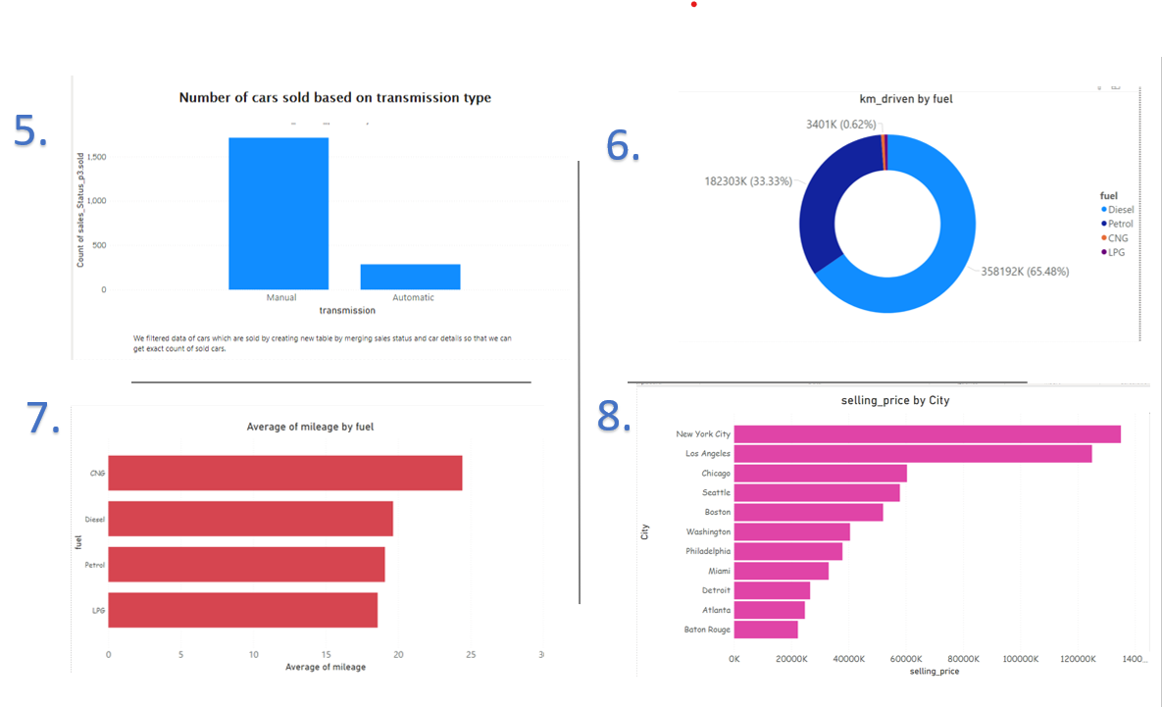
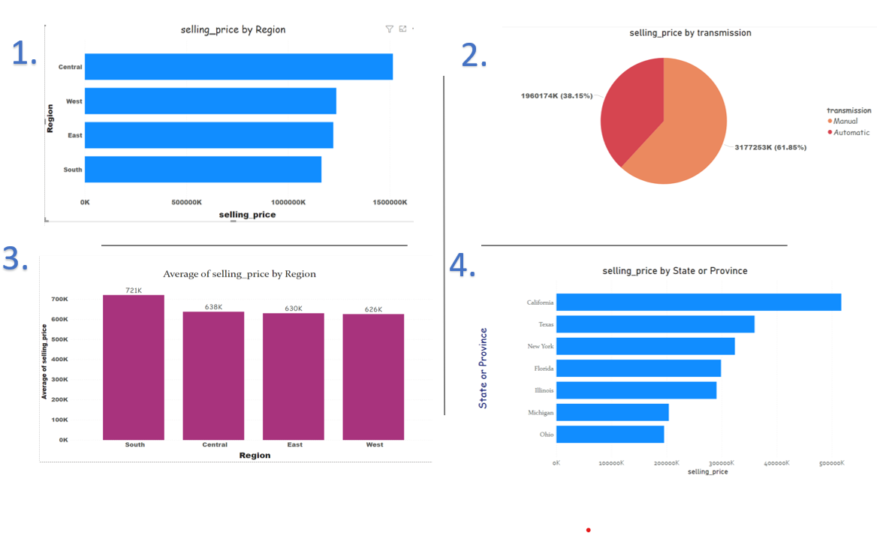
Create a Linked service to PowerBI
PowerBI Analytics

Slide 48
Deployment of Machine Learning model using Flask

Slide 49
Flask
A Python web Framework
Building Web Application
Displays HTTP Response by HTTP Client
Provides detailed error messages
Flask is Pythonic

Slide 50
I) Download Pickle File of the model created.
STEPS:
II) Create HTML file to read input values through template to find selling price of car
III) Create Flask Application and Deploy ML pickle file in it.

Slide 51
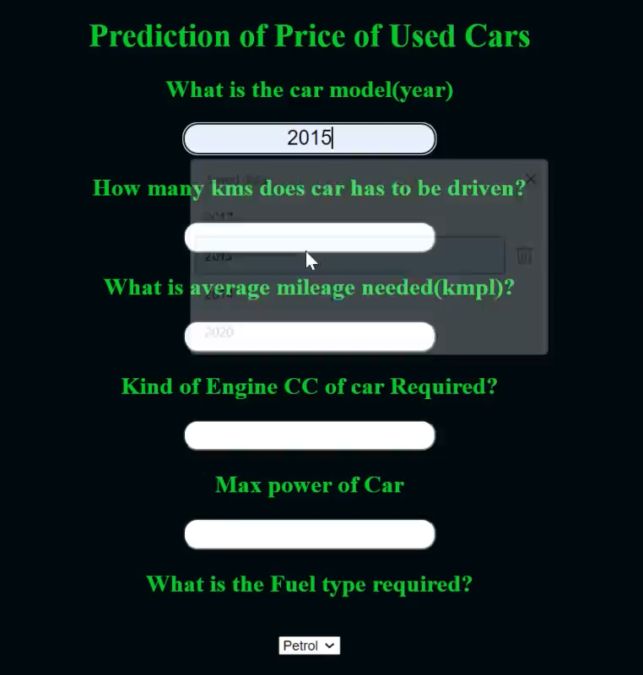

Slide 52


